Slide 1

L4/5 GROUP 13
Amy Potter
Sean Turner
Alex Mednick
Alex Turnbull
Notes:
GOLD PITCH
The process the game went through
Features of game
What players did/didn’t like
Iterations we made
How we would continue - strip back artwork and focus on visual hierarchy/silhouettes
What went well/what didn’t

Slide 2
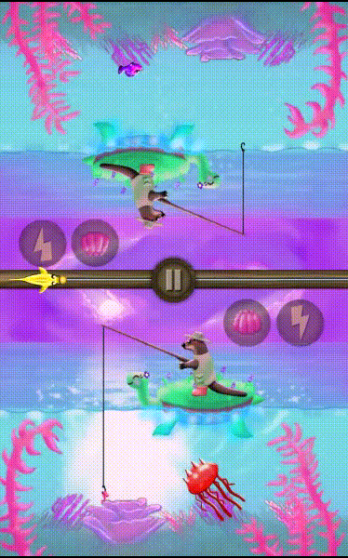
Game Features
Symmetrical gameplay
Tactical options with power-ups
Rubber-banding for close games
Full menu system
AP
Notes:
Our game is an adversarial, turn-based symmetrical game where players tap once to reel in a fishing line, instantly starting their opponent’s turn. Fish move at all times on both sides, so players make decisions about the best time to catch or avoid certain fish.

Slide 3

Playtest video and Feedback
https://www.youtube.com/watch?v=al1T4_yCcnE&feature=youtu.be
Notes:
https://www.youtube.com/watch?v=al1T4_yCcnE&feature=youtu.be

Slide 4
Playtesting Feedback
SFX jarring in comparison to the background music
Jellyfish looks like it would give a high number of points due to its size
AM
Notes:
SFX distract from style of gameplay, game is quite cute and SFX are jarring in comparison
Jellyfish looks like it would give high number of points due to its size etc. despite the fact that it has spikes, especially because big fish appears ominous

Slide 5
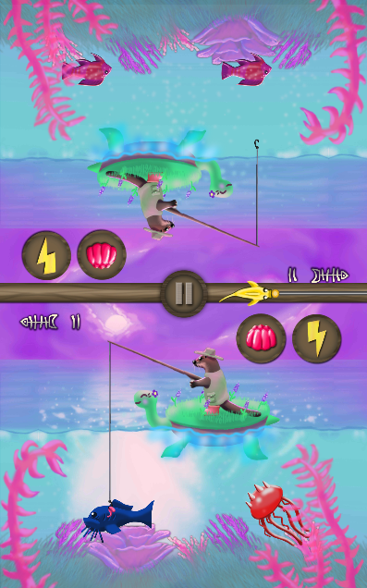
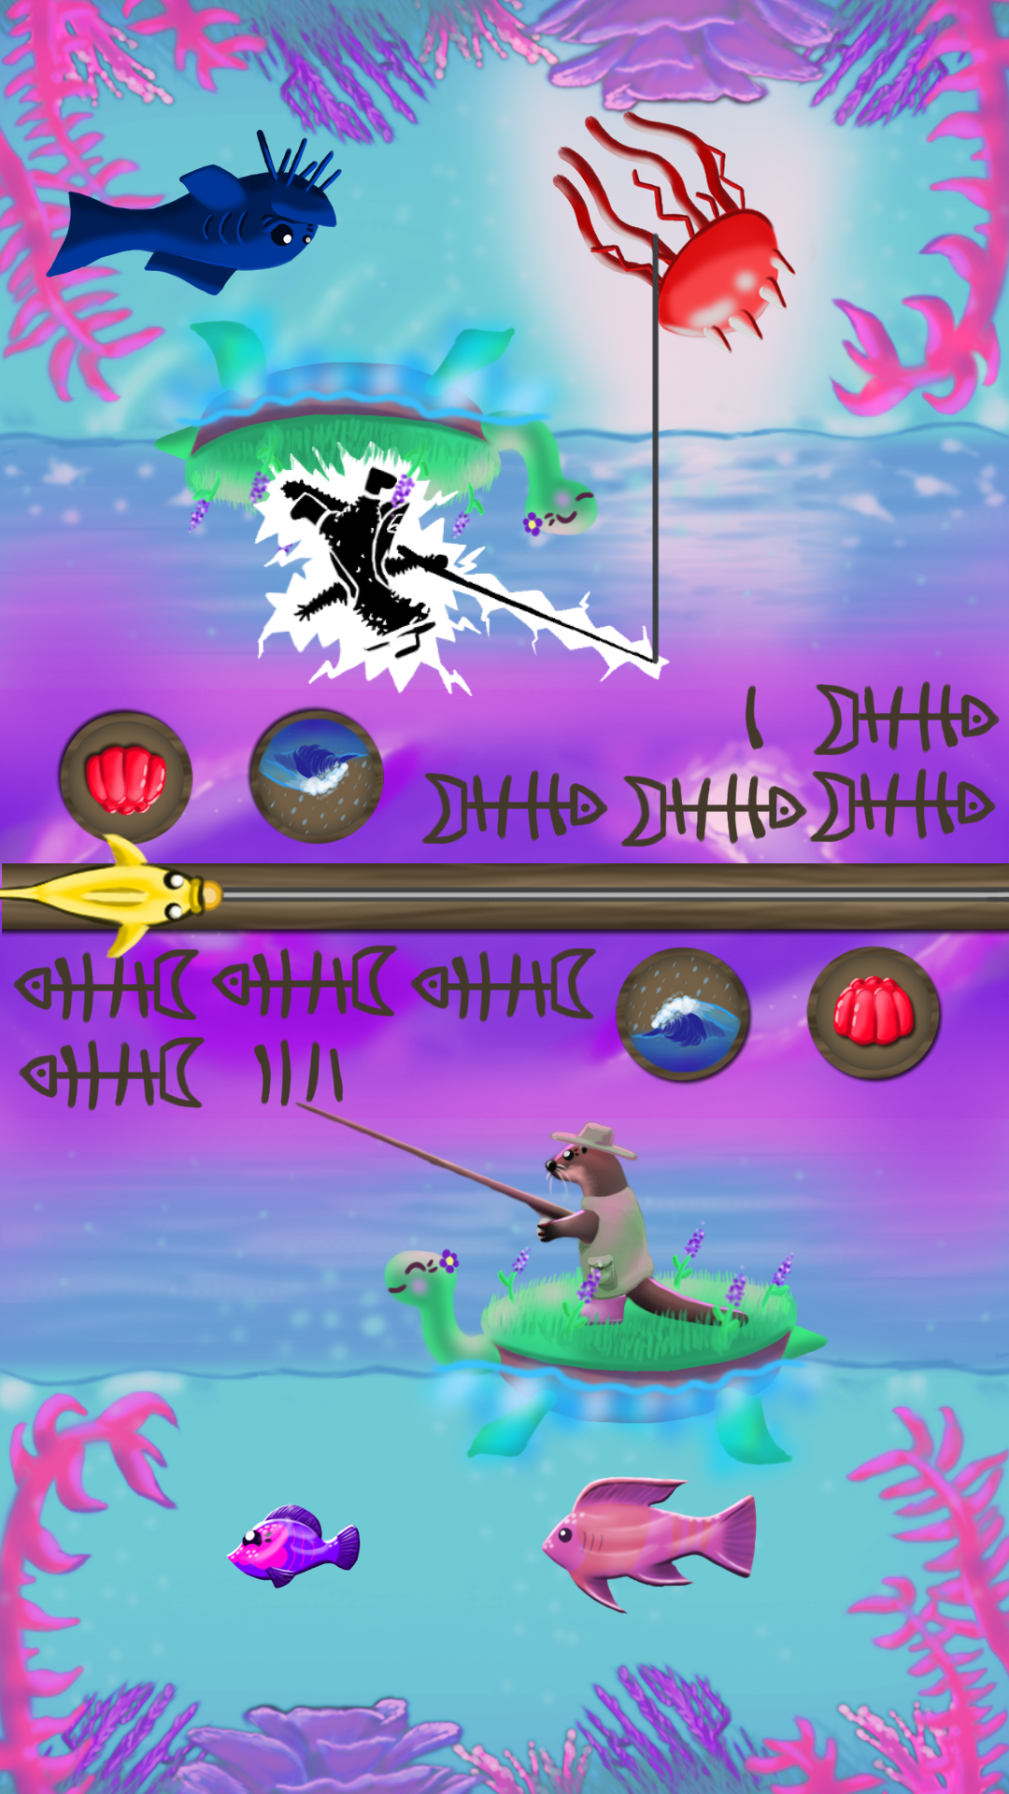
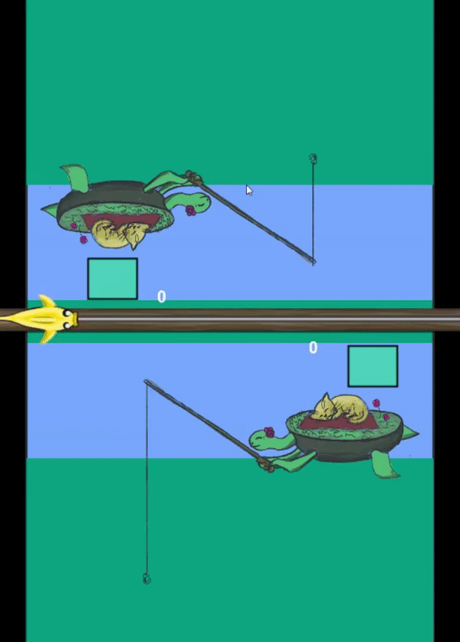
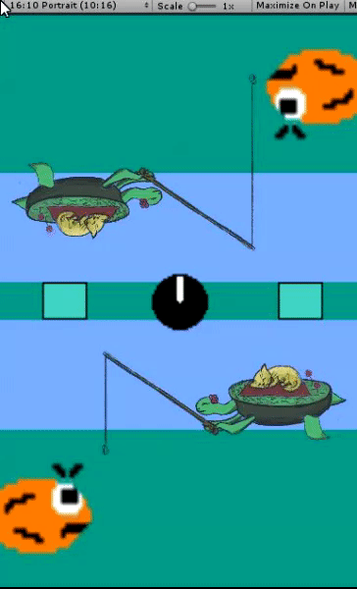
Iterations
(Based on tutor and playtesting feedback)
Clearer interface
More distinct and recognisable assets
Particles!
ST

Slide 6



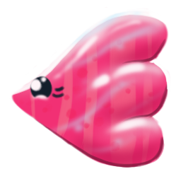


Improved Visual Clarity

Slide 7
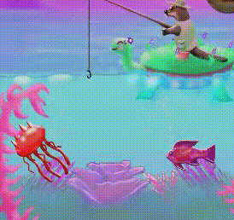
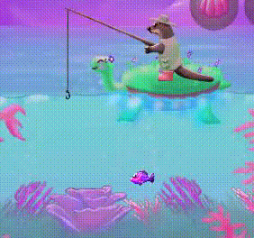
Particles

Slide 8

Improvements Out of Our Scope
Despite rubber-banding, the randomness of jellyfish spawning can still lead to balance problems
Checks in code for stopping unfair situations from occuring
Strip back artwork and focus on visual hierarchy
PC / Background animation
AT
Notes:
The random nature of fish spawning can lead to unfair situations even though we try to influence it with probabilities and rubber banding. With more time, we could implement checks to ensure that a player doesn’t get an unfair number of jellyfish, too many big fish, and other random occurrences which can spoil a game. Relying on the randomiser isn’t a big problem as the game is intended to be played multiple times by the same two players so the randomness should balance out, but it would be nice to implement some hard checks if we had more time.

Slide 9
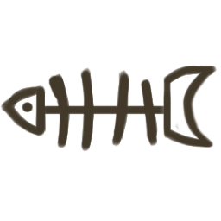

Key Design Lessons
Don’t overcomplicate design
Keep assets clear and distinct
Make the important info obvious
ST

Slide 10
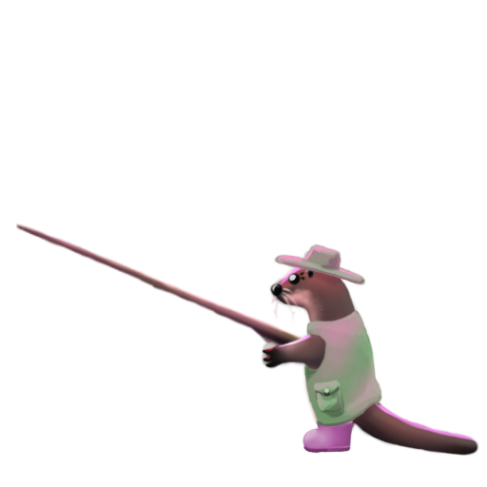
Key Programming Lessons
Importance of commenting code
Refactor code as parts are developed
Identify and rectify issues early as possible
Style guide
AT + AM
Notes:
A point in the project where designers needed to contribute to Unity project but couldn’t understand code
Also made it difficult for manager to verify tasks

Slide 11
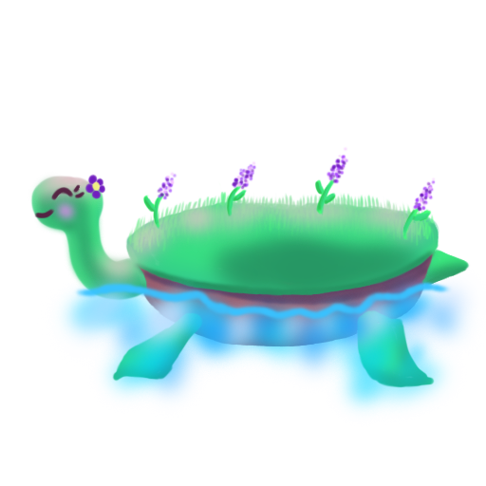
Key Management Lessons
Set deadlines for tasks
Clarity of tasks
Be more assertive
Write clear meeting minutes
AP

Slide 12
Questions?

